Slide 1
How local farmland mitigation policies are Effective in protecting the working landscape

Slide 2
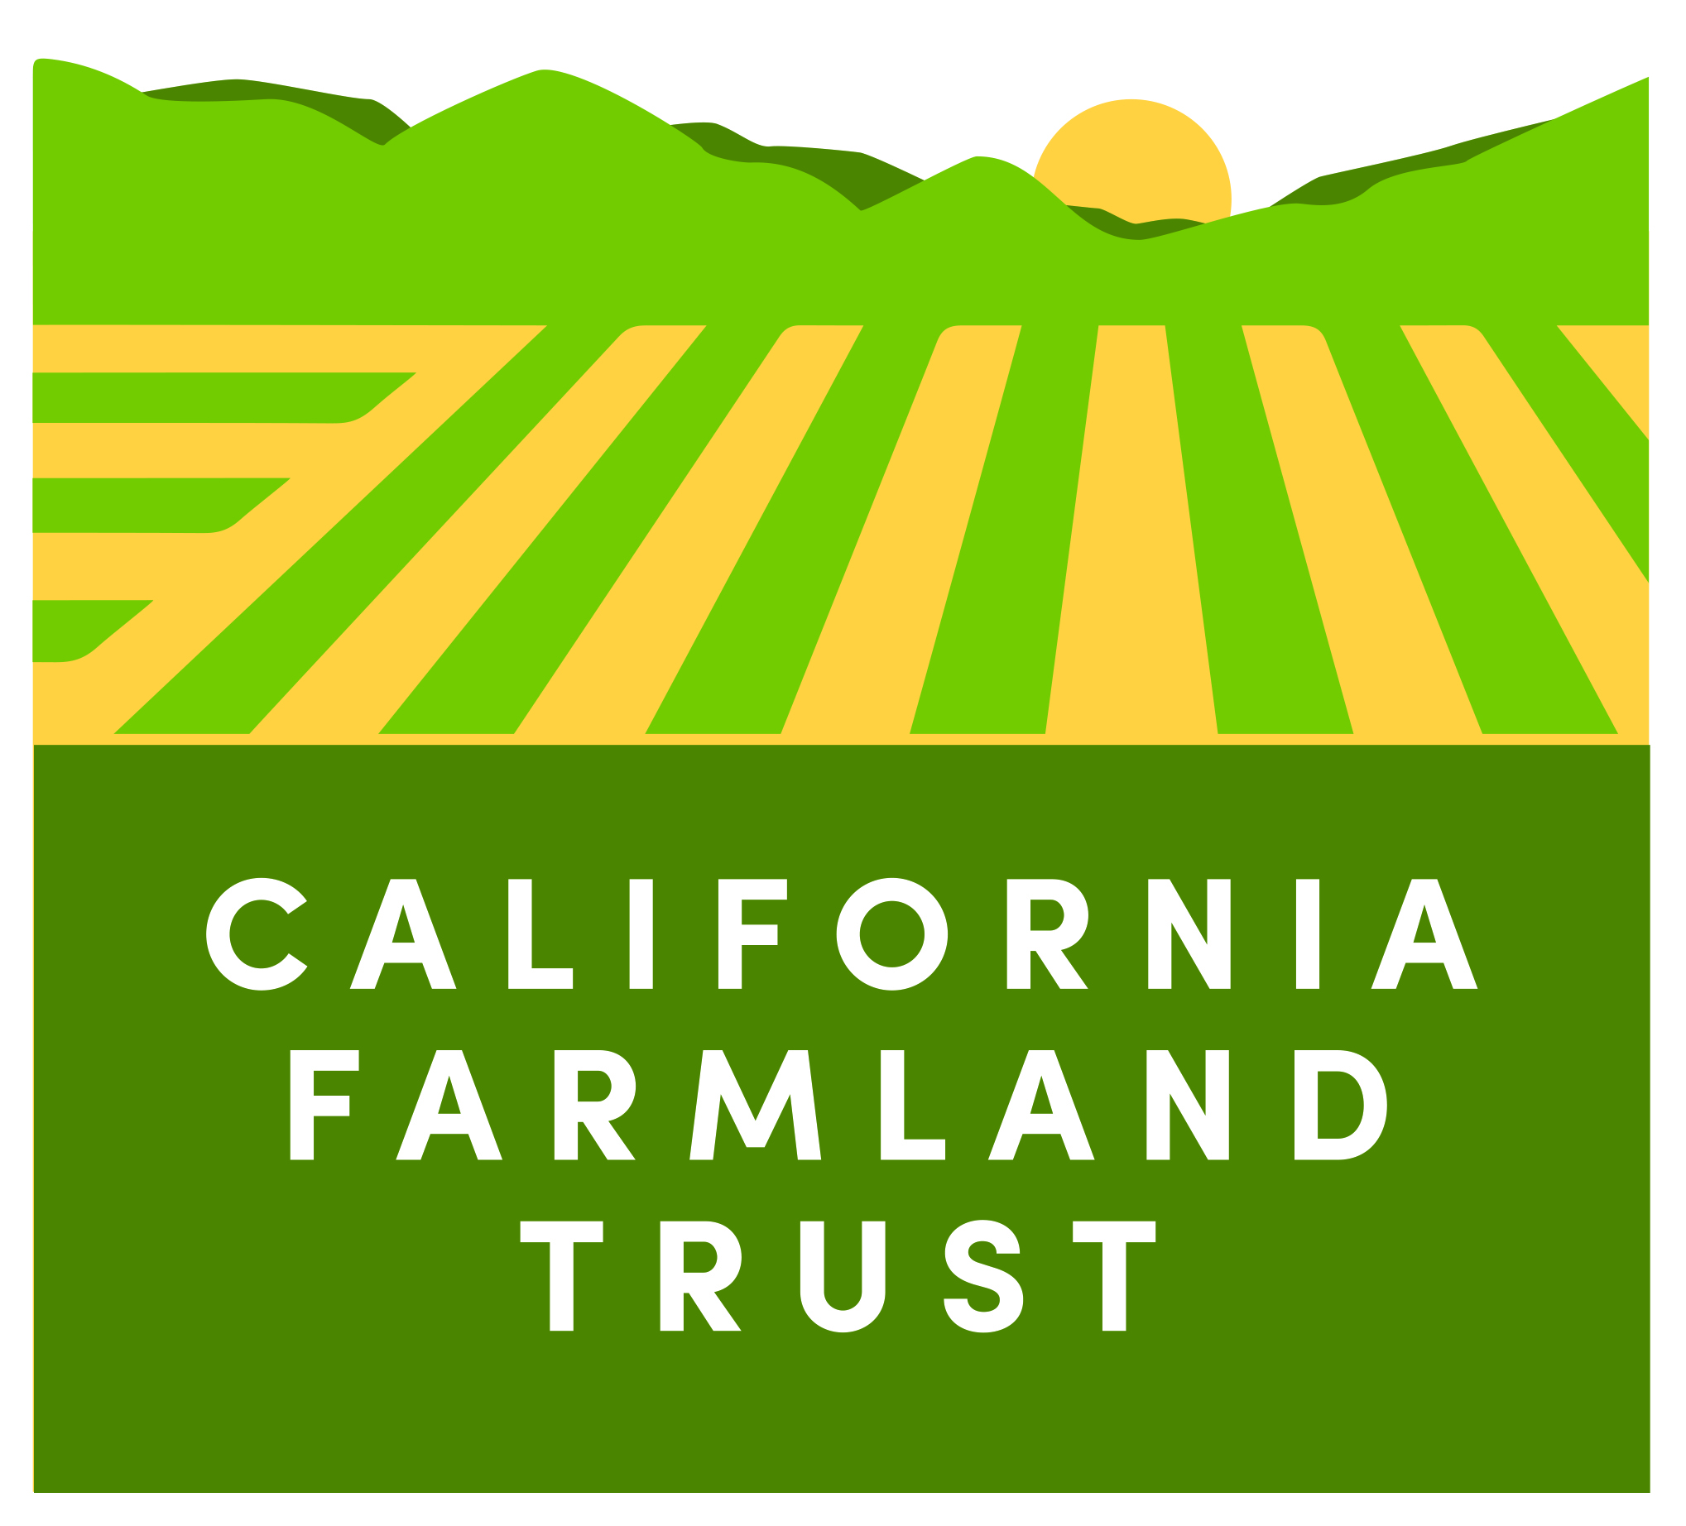
Central Valley Farmland Trust is now California Farmland Trust
Board decision after merging with the Brentwood Agricultural Land Trust to help in areas where farmland protection is needed and not done so by other land trusts.
Current service area is Contra Costa, Sacramento, San Joaquin, Stanislaus, Merced, and Madera Counties.
Our mission remains the same with our primary focus on protecting irrigated agriculture.

Slide 3
Why protect farmland
9 million acres of California’s land mass has the right kinds of soils to grow crops.
California has a unique Mediterranean climate to grow for longer seasons.
Over the last thirty years we have lost about 500,000 acres of this precious soil to other non-agricultural uses.
Anticipated further rapid loss of farmland over the next 30 years as our population will soar.

Slide 4
Why protect farmland
California is #1 food and agricultural producing state in the nation.
California is the largest exporter of agricultural products.
California is sole producer of array of commodities all over the world: pomegranates, olives, artichokes, almonds
Farm gate value of $45.3 billion. Ag directly accounts for 10.2% of jobs in California.

Slide 5
Why protect farmland
Environmental: provide habitat, sequester carbon, reduce green house gas emissions associated with urban vehicle traffic, groundwater recharge.
View Shed, Open Space, Distinction between communities, Watershed protection, flood protection

Slide 6
Farmland loss
Traditional urban sprawl, big-box stores, rural ranchettes
Infrastructure development; solar energy projects, High Speed Rail, water conveyance
Oil and natural gas extraction

Slide 7
Existing Farmland Protection Tools
Williamson Act (CA Land Conservation Act). Offers 10-year and 20-year contracts to provide a lower property tax rate for farmers and ranchers in exchange to keep their land in agriculture.
Since 2009 the California legislature nearly eliminated subvention payments to counties.
Not an effective tool to reduce sprawl
Local Land Use Planning - Only works when political leaders are invested.
Agricultura Zoning
Community Blueprints
Local Agency Formation Commissions

Slide 8
Funding tools/Process
State and Federal Grant Programs
Local Government Mitigation Ordinances
Conditions on Development Approvals
From CEQA review or locally adopted ordinance requirement to pay ag mitigation in lieu fee.
Small development projects that need to mitigation for farmland loss
1:1 agricultural mitigation ratio

Slide 9
Need stronger policies
Consistent farmland protection policies throughout CA
Local jurisdictions need to look out to 20 year growth projections not 100 year
Urban limit lines to be robust and protected
Fund Williamson Act
Require all County General Plans to have Agriculture Element (Chapter)
Encourage LAFCo to not auto stamp SOI/annexation proposals
CA Environmental Quality Act (CEQA) does not provide the level of scrutiny for farmland protection

Slide 10
Some Great resources!
State of the Art on Agricultural Preservation, February 2018
American Farmland Trust
Triple Harvest: Farmland conservation for climate protection, smart growth and food security in California, February 2013
CA Climate and Ag Network
Conserving CA Harvest, A model mitigation program and ordinance for local governments
CA Council of Land Trusts

